Slide 1
Analysis of Employees Satisfaction Index Data
Submitted By:
RAJ JADHAV

Slide 2


SOURSE OF DATA https://www.kaggle.com/mohamedharris/employee-satisfaction-index-dataset
Video Link

Slide 3

Problem Statements
Department wise number of certifications.
Rating wise count of employees.
Rating of employees in each department.
Satisfied employees in city & suburb location.
Recruitment type wise satisfied employees.
Under Graduate(UG) & Post Graduate(PG) employees in each department.
Ratings of employees in various age group.
Awards received by various age group.
Awards received by each department.
Salary expenses in each department.
Salary expenses for various job levels.
Age wise no. of employees.

Slide 4

Executive Summery
-Purchasing dept. has more certificate holders and more number of high rated employees.
-Tech. department has less salary expences as compare to other department. Suburb & city employees are equally satisfied with the company.
-There are large no. of young employees having 5 rating.
-Balance between no. of young and old employees.

Slide 5
Department-Wise Certification
Analysis:-
-Sales department has highest number of certification in employees while marketing department has less number of certification

Slide 6
Department-Wise Employees Rating
Analysis:-
-Purchase department has highest number 5 rated employees as well as low number of 1 rated employees.

Slide 7
Satisfied Employees in Each Location
Analysis:-
-Employees from suburb & from city location are equaly satisfied.

Slide 8
Recruitment Type Wise Satisfied Employees
Analysis:-
-Graph shows number of employees who placed through recruitment agency is less.

Slide 9
Graduation Wise Employees in Each Department
Analysis:-
-Sales department has large difference between number of under graduate & post graduate employees.
-Purchase department has more number of PG student &Technology department has more number of UG student.

Slide 10
Rating of Employees in Various Age Group
Analysis:-
-Age group 25-29 has more number of 5 rated employees.
-Age group 50-54 has balance between number of 1 to 5 rated employees.

Slide 11
Department & Age Wise Number of Awards
Analysis:-
-50-54 age group has more number of awards in technology department.
-20-24 age group has less number of award in HR department which is lower in overall list.

Slide 12
Salary Expenses
Analysis:-
-Graph shows job level wise gradually increase in salary expenses.
-Purchase department has more salary expenses as compare to other department, while technology department has less salary expenses as compare to other department

Slide 13
Age-Wise Number of Employees
Analysis:-
Graph shows there is age wise balance between number of employees.

Slide 14
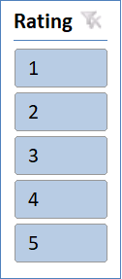
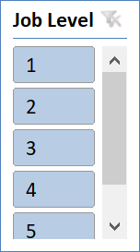
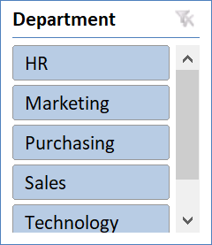
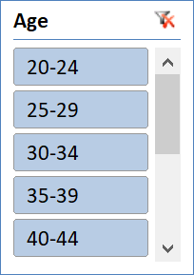
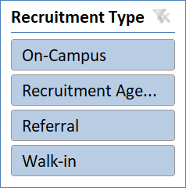
DASHBOARD
REFRESH

Slide 15

CONCLUSION
Company needs to concentrate on factors like employees wages, promotion this will result more employee satisfaction & employee satisfied means improve companies productivity, increase sales of company.

Slide 16


